Slide 1
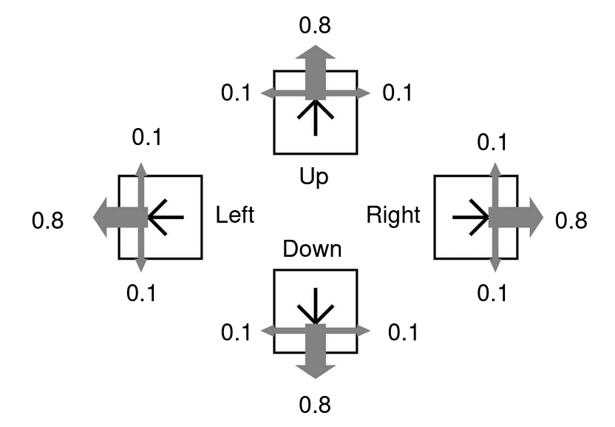
0.95
0.025
0.025
0.025
0.025
0.95
0.95
0.025
0.025
0.025
0.025
0.95

Slide 2
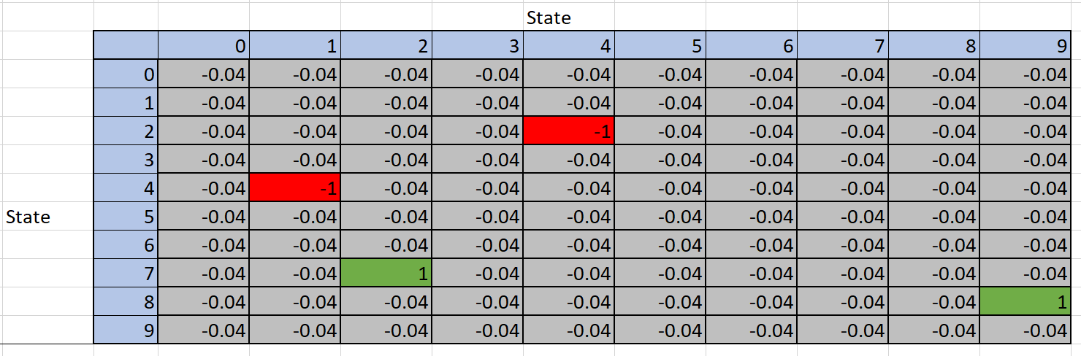
Reward of 1 for being in state (8,9)

